Slide 1
Final Presentation

Slide 2
Overview
Remote
Planner
Record
Metadata
Parser
Query
Transaction
Buffer
Log
File

Slide 3
Overview
Remote
Planner
Record
Metadata
Parser
Query
Transaction
Buffer
Log
File

Slide 4
Select *
RemoteStatementImpl
Using eatID() function, we define ‘*’ character by matching delimeter
BasicQueryPlanner
Execute ProjectPlan() function
ProjectPlan
Lexer
Parser
Planner
Execute CreateQueryPlan() using Input SQL Query
Execute Parser’s query() function
Using selectList() function, get field name
By adding arguments, we can use table manager and get all field names

Slide 5
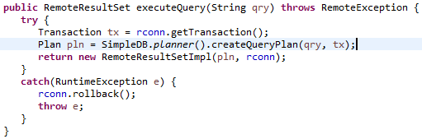
Source Code
RemoteStatementImpl

Slide 6

Source Code
Planner

Slide 7
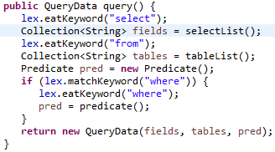
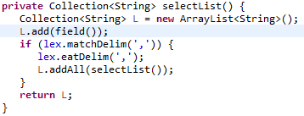
Source Code
Parser

Slide 8
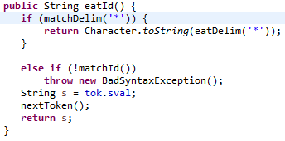
Source Code
Lexer

Slide 9
Source Code
Planner

Slide 10
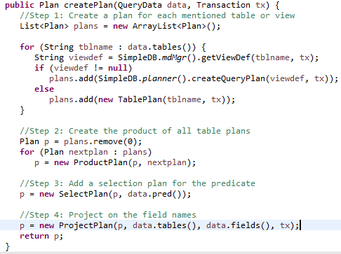
Source Code
BasicQueryPlanner
Add two arguments in ProjectPlan

Slide 11
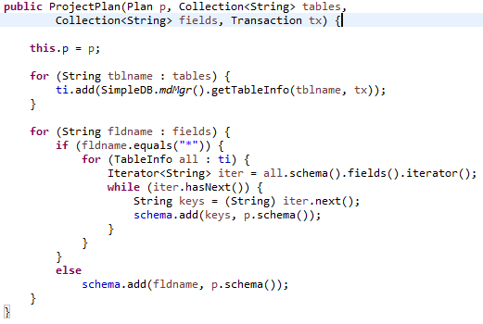
Source Code
ProjectPlan
Use tablescan and get all field name as well as the contents of the table

Slide 12
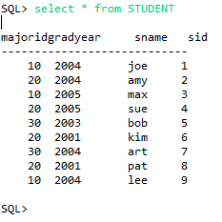
Example
Select * from STUDENT

Slide 13
Where Clause (Predicate)
RemoteStatementImpl
Execute plan.open() function
SelectScan
Using Term’s isSatisfied() function, check whether predicate is right
Term
RemoteResultSetImpl
Parser
Planner
Execute CreateQueryPlan() using Input SQL Query
Execute Parser’s query() function
Using Predicate() function then execute Term() function
Compare right expression and left expression

Slide 14
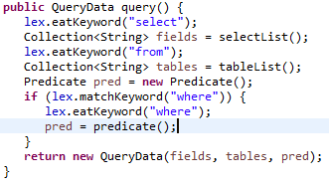
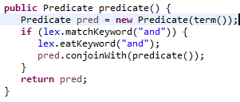
Source Code
Parser

Slide 15
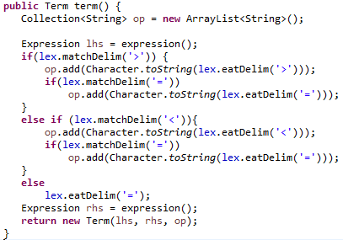
Source Code
Parser
Added “op” to define
>,<,>=,<=

Slide 16

Source Code
RemoteResultSetImpl

Slide 17

Source Code
SelectScan
Check whether the predicate is correct

Slide 18
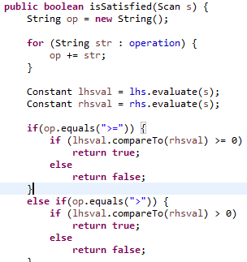
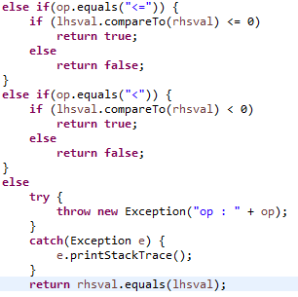
Source Code
Term

Slide 19
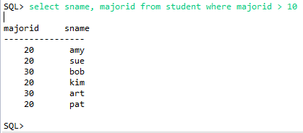
Example
Select Sname, MajorId from STUDENT where majorId > 10

Slide 20
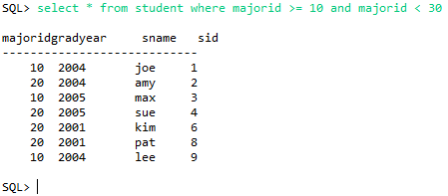
Example
select * from student where majorid >= 10 and majorid < 30

Slide 21

Q&A

